Slide 1
Rossmann Store Sales Prediction
Domain – Retail
By – Rupali Surendra Dalvi

Slide 2
Content
Context
Problem Statement
Deliverables
Impact
Exploratory Data Analysis
Dataset & Features
Importing Packages
Data Preprocessing & Cleaning
Model Building
Linear Regression
Decision tree
Random Forest
Best Outcome
Conclusion

Slide 3
Context
Rossmann is the largest drugstore in Germany. Moreover, it operates over 3,000 drug stores in 7 European countries. Currently, Rossmann store managers are tasked with predicting their daily sales for up to six weeks in advance.
Store sales are influenced by many factors, including promotions, competition, school and state holidays, seasonality, and locality. With thousands of individual managers predicting sales based on their unique circumstances, the accuracy of results can be quite varied. In this project we are predicting sales for 1,115 stores located across Germany. Reliable sales forecasts enable store managers to create effective staff schedules that increase productivity and motivation.
In this project, we applied machine learning techniques to a real ­world problem of predicting stores sales. This kind of prediction enables store managers to create effective staff schedules that increase productivity and motivation. We used feature selection, model selection to improve our prediction result. In view of nature of our problem, Mean Absolute Error (MAE), Root , Mean Squared Error (MSE), Root Mean Square Error (RMSE) is used to measure the prediction accuracy.

Slide 4
Problem Statement
The primary goal is to build a predictive model that can forecast daily sales for each Rossmann store accurately. The model should take into account the following factors:
Store-specific attributes, such as store type and assortment level.
Historical sales patterns.
The impact of promotions and advertising campaigns.
Seasonal effects, such as holidays and special events.

Slide 5
Deliverables
The project's deliverables will include:
A well-documented and trained predictive model.
A comprehensive analysis of feature importance to understand the factors driving sales.
Visualizations and insights into sales patterns and trends.
Recommendations for optimizing inventory management and promotional strategies based on the model's insights.

Slide 6
Impact
The successful implementation of an accurate sales prediction model will enable Rossmann to:
Optimize inventory levels, reducing the risk of overstocking or understocking products
Efficiently allocate staff resources by matching workforce to expected customer demand
Plan and execute promotions and marketing campaigns more effectively
Improve overall operational efficiency and profitability across its stores
This project aims to leverage data-driven insights to enhance Rossmann's store management practices, ultimately leading to improved customer satisfaction and financial performance

Slide 7
Exploratory data analysis (EDA) Exploratory data analysis (EDA) is A crucial step in the data analysis process. It involves the initial investigation and summary of a dataset to understand its main characteristics, patterns, and potential issues
EDA
Data Collection
Data Preprocessing
Data Cleaning
Data Visualisation

Slide 8
Dataset & Features
The dataset contains historical sales data for a period of approximately 2.5 years, encompassing various Rossmann stores.
It includes information such as store attributes, daily sales figures, details of promotions, and date-related information.
The data provides valuable insights into the dynamics of sales within each store.

Slide 9
Training Dataset-
Training data is comprised of two parts. One part is historical daily sales data of each store from 01/01/2013 to 07/31/2015.
This part of data has about 1 million entries. Data included multiple features that could impact sales. Table 1 describes all the fields in this training data.
Attribute | Features
Store | A unique identifier for each store in the dataset. This feature is typically represented as an integer or categorical variable.
DayOfWeek | An integer representing the day of the week (1 for Monday, 2 for Tuesday, and so on) for each record in the dataset. This feature helps capture the day-of-week effects on sales.
Date | The date for each record. This feature allows for time series analysis and captures temporal patterns and trends.
Sales | The target variable representing the daily sales of each store. This is the variable that the predictive model aims to predict.
Customers | The number of customers who made purchases on a given day at each store. This feature can provide insights into customer behavior and its impact on sales.
Open | A binary variable (0 or 1) indicating whether the store was open or closed on a given day. Closed stores typically have no sales.
Promo | A binary variable (0 or 1) indicating whether a store was running a promotion on a given day. Promotions can influence sales and customer traffic.
StateHoliday | A categorical variable indicating whether a state holiday was observed on a given day (0 for no holiday, "a" for public holiday, "b" for Easter holiday, and "c" for Christmas).
SchoolHoliday | A binary variable (0 or 1) indicating whether a school holiday was observed on a given day. School holidays can affect customer behavior and sales.
Table 1: Historical sales data table features

Slide 10
Table 2: Store Information data table features
Store Dataset - The second part of training data is supplement store information. It has 1115 store info entries, which listed the store type, competitor and a different kind promotion info. Table 2 below describes all the field in this file.
Attribute | Features
Store | A unique identifier for each store in the dataset. This feature is typically represented as an integer or categorical variable.
StoreType | A categorical variable representing the type of store (e.g., "a" for small store, "b" for compact store, "c" for standard store, "d" for extra-large store).
Assortment | A categorical variable indicating the assortment level (e.g., "a" for basic, "b" for extra, "c" for extended) of products available in the store.
CompetitionDistance | The distance to the nearest competitor store. This feature can influence store performance, as stores with closer competitors may face more competition.
CompetitionOpenSinceMonth | This feature is typically represented as an integer value, indicating the calendar month (1 to 12) when a competitor store opened in close proximity to the Rossmann store. Each month of the year is numbered, and this feature specifies the opening month of the competitor store.
CompetitionOpenSinceYear | This feature specifies the opening year of the competitor store.
Promo2 | Promo2 is a promotional program that the store is running. It's represented as a binary variable (0 or 1), where 1 indicates that the store is participating in Promo2, and 0 indicates it is not.
Promo2SinceWeek | This feature provides information about when the store started participating in Promo2. It is typically represented as an integer value, indicating the calendar week (1 to 52) when the Promo2 program was initiated for the store. Each week of the year is numbered, and this feature specifies the starting week for the promotion. For example, if "Promo2SinceWeek" is 10, it means that the store began participating in Promo2 starting from the 10th week of the year.
Promo2SinceYear | It specifies the year in which Promo2 promotions started for the store.
PromoInterval | This feature describes the intervals at which the Promo2 promotions occur for the store. It is a categorical variable that can take on values such as: "Jan,Apr,Jul,Oct" (Promo2 occurs in January, April, July, and October)

Slide 11
Import Packages
import pands as pd
import numpy as np
import matplotlib.pyplot as plt
import pygwalker as pyg
import seaborn as sns
import plotly.graph_objs as go
import plotly.offline as py
from sklearn.model_selection import train_test_split
from sklearn.linear_model import LinearRegression
from sklearn.tree import DecisionTreeRegressor
from sklearn.ensemble import RandomForestRegressor
from sklearn import metrics

Slide 12
Data Preprocessing & Cleaning
Load Dataset
Functions Used :
df.head()
df.tail()
df.info()
df.shape()
.unique()
Dealing With Missing Values
Count missing values in each dataset
Replace missing values in features with low percentages of missing values
Remove features with high percentages of missing values

Slide 13
Data Preprocessing & Cleaning
Joining Tables
In this process tables are joined to combine information from multiple sources in order to create a comprehensive dataset that provides a more complete and informative context for predicting store sales accurately.
Feature Engineering
Feature engineering is the process of creating new features (variables) from existing data that enhance the performance of machine learning models. It involves selecting, transforming, and creating features to improve the predictive accuracy of a model. Feature engineering is a critical step in the data preprocessing pipeline, as the quality and relevance of features significantly impact the model's performance. Eg We have extracted day, month, quarter, year, day of year & week of year from column "Date“ and Created new Column for the season
Drop Subsets Of Data Where Might Cause Bias
When working with data, it's important to identify and, if necessary, drop subsets of data that might cause bias in your analysis or modeling. Bias in data can lead to skewed results and incorrect conclusions. Eg where stores are closed, they won't generate sales, so we will remove this part of the dataset
Transform Variable
Transforming a variable means changing its values in some way to make it more suitable for analysis or modeling Eg. "StateHoliday“ : A categorical variable indicating whether a state holiday was observed on a given day (0 for no holiday, "a" for public holiday, "b" for Easter holiday, and "c" for Christmas). Here we convert in into numeric

Slide 14
Data Visualisation
Data visualization is the graphical representation of data to help people understand and interpret information more effectively. It plays a crucial role in data analysis, as it allows you to visually explore patterns, trends, relationships, and insights within your data. Effective data visualization can make complex data more accessible and can aid in decision-making.
There are various types of data visualizations, including:
Bar Charts: Used for comparing categories or groups.
Line Charts: Show trends over time or continuous data.
Scatter Plots: Display relationships between two variables.
Histograms: Visualize the distribution of a single variable.
Pie Charts: Show parts of a whole.
Heatmaps: Depict data using color-coding on a grid.
Box Plots: Represent the distribution, quartiles, and outliers of a dataset.
Maps: Display geographical data.

Slide 15
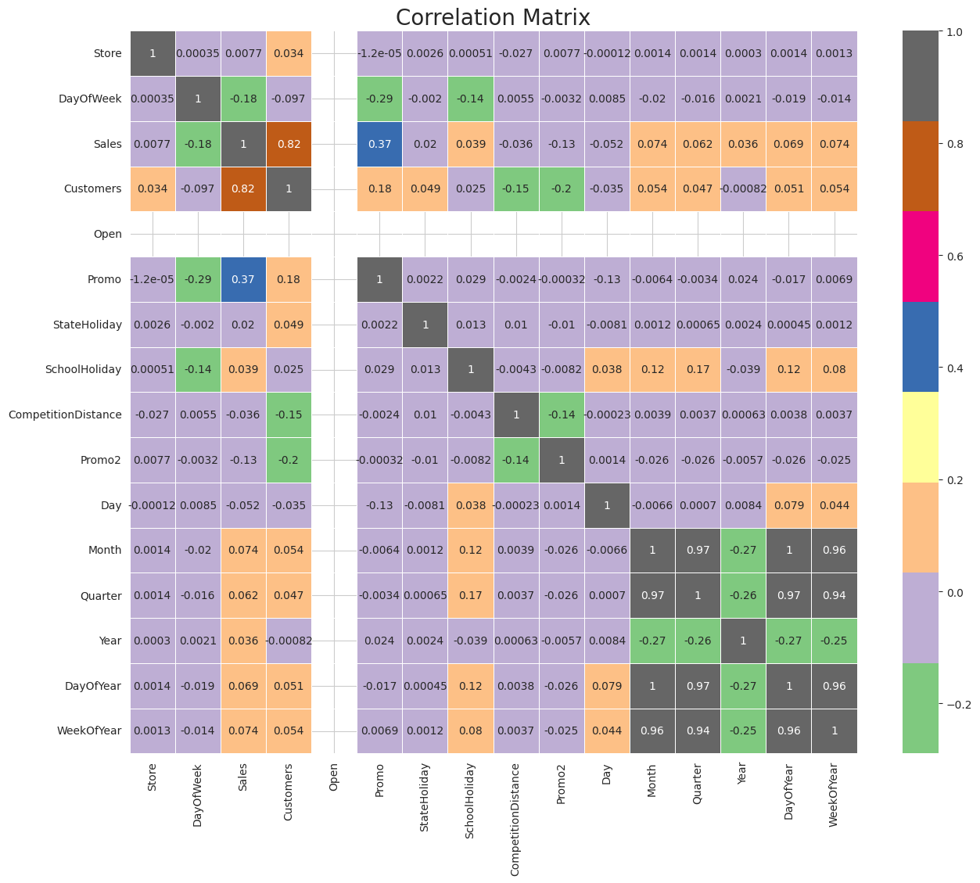
Correlation heatmap A correlation heatmap is used to visually represent the correlations (relationships) between variables in a dataset. It is a common data visualization technique that provides valuable insights into how variables are related to each other.

Slide 16
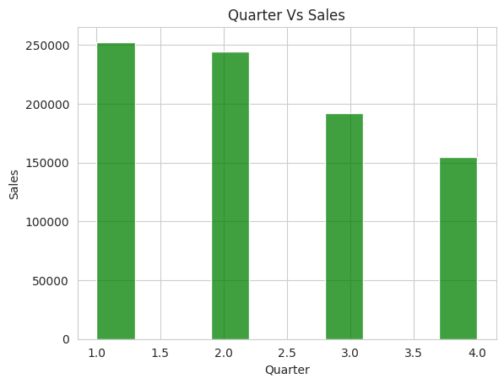
Quarter Vs Sales

Slide 17
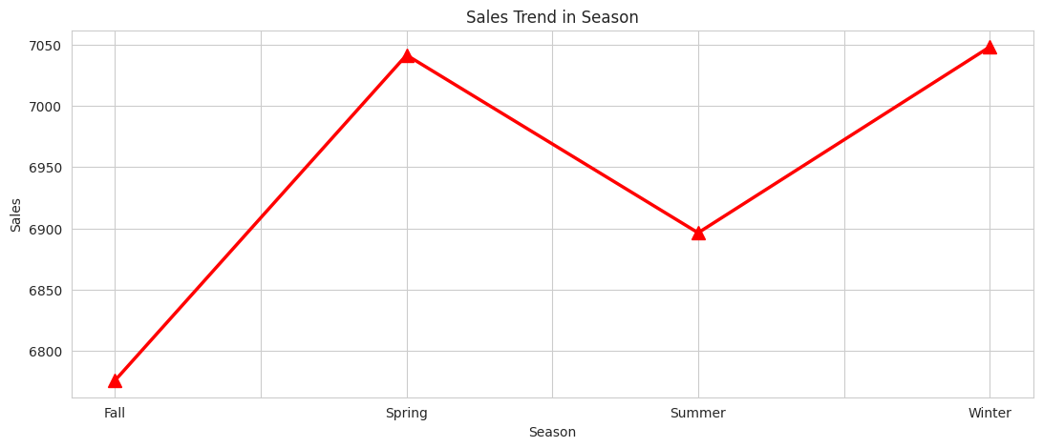
Sales Trend in Season

Slide 18
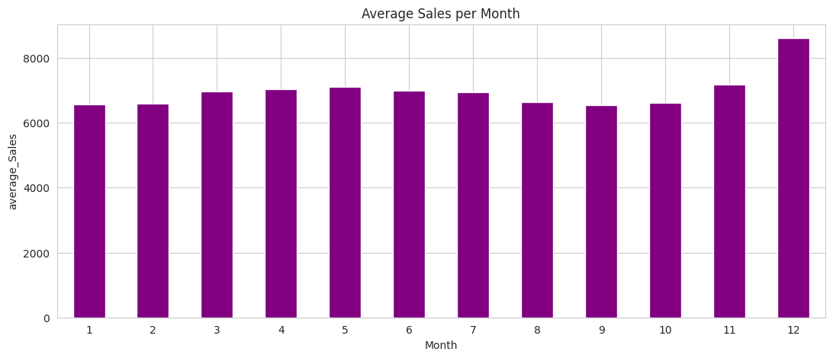
Average Sales Per Month

Slide 19
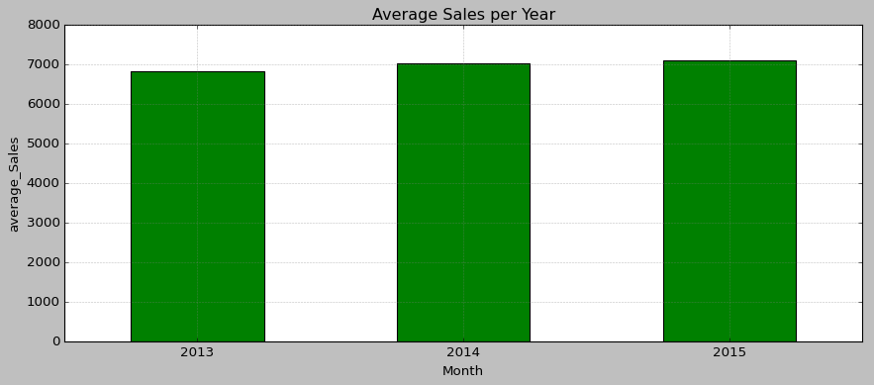
Average Sales Per Year

Slide 20
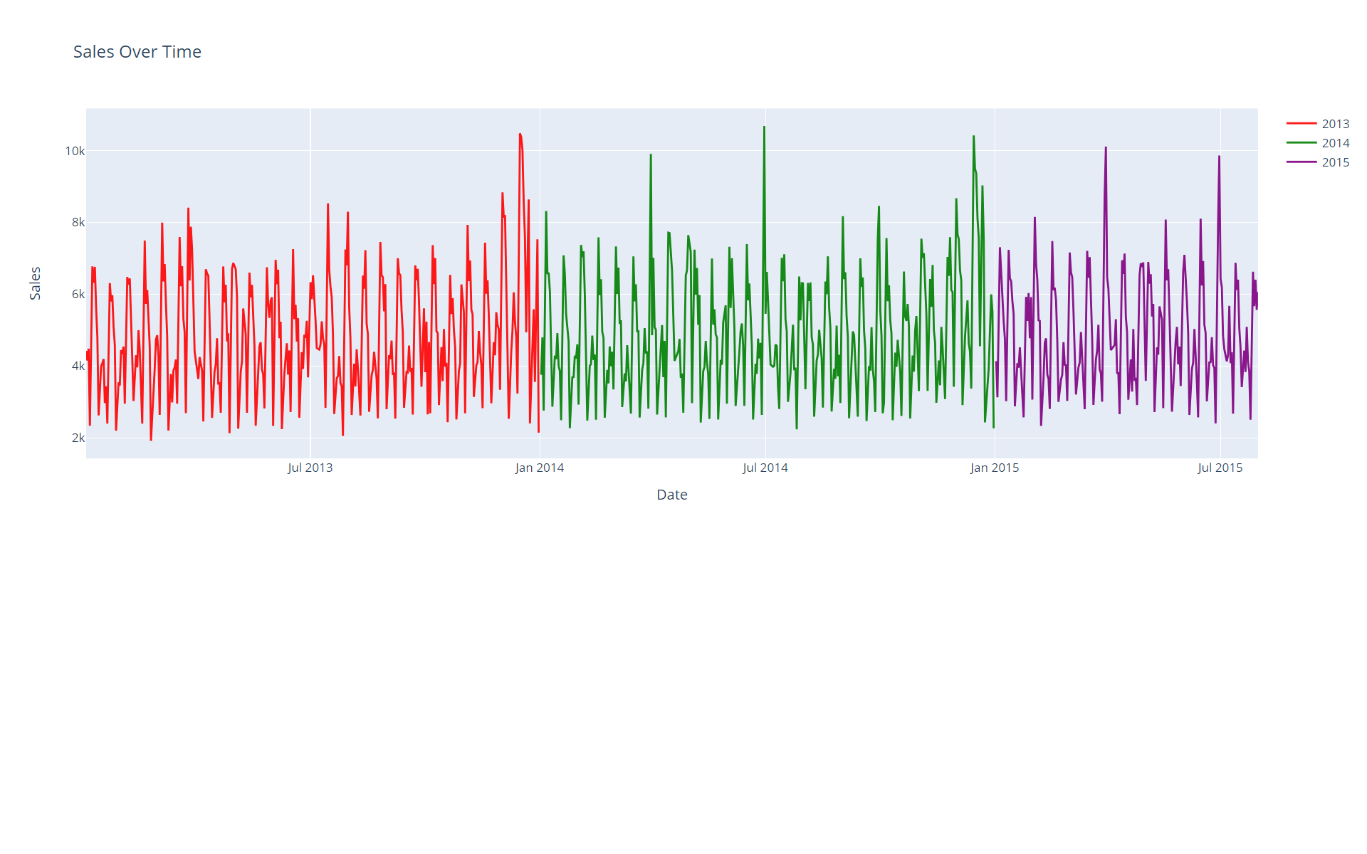
Sales Over Time(Year)

Slide 21
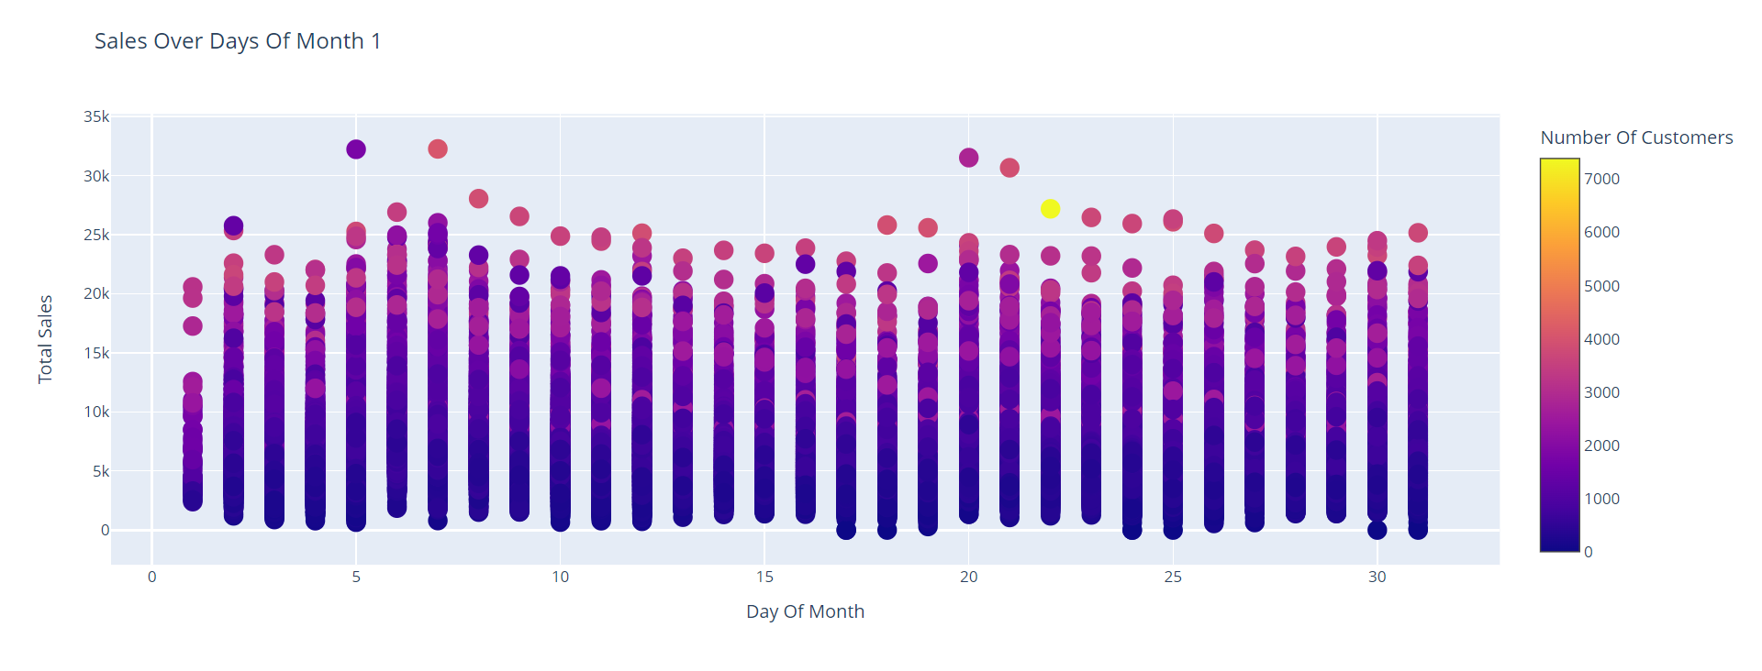
Sales Over Days Of A Month

Slide 22
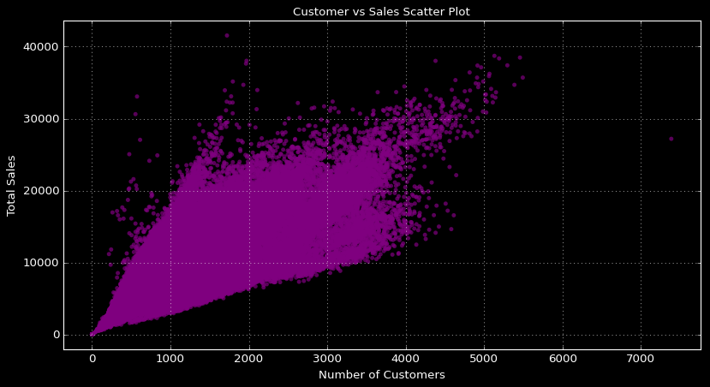
Sales vs. Number Of Customers

Slide 23
Model Building
Selecting the right machine learning algorithm for your task is a crucial decision in the model building process. The choice of algorithm depends on various factors, including the nature of your problem, the characteristics of your data, and your goals (e.g., classification, regression, clustering)
Here we have implemented the below models:
Multiple Linear Regression
Decision Tree
Random Forest

Slide 24
Multiple linear regression multiple linear regression is a statistical method used for modeling the relationship between multiple independent variables (predictors) and a single dependent variable (target) by fitting a linear equation to the observed data. It extends the concept of simple linear regression, which deals with only one predictor variable, to handle situations where there are multiple predictors.
Measures | Accuracy Score of Linear Regression Model | Accuracy Score of Multiple Linear Regression Model
Mean Absolute Error | 1238.22 | 1096.35
Mean Squared Error: | 2800530.99 | 2340869.96
Root Mean Squared Error | 1673.48 | 1529.99
R Squared | 0.70 | 0.75

Slide 25
Decision tree A decision tree is a popular supervised machine learning algorithm used for both classification and regression tasks. It is a tree-like model that makes decisions or predictions based on a sequence of if-else conditions applied to the input data. Decision trees are easy to understand and interpret.
Measures | Accuracy Score of Decision Tree Algorithm
Mean Absolute Error | 1004.17
Mean Squared Error: | 2012871.10
Root Mean Squared Error | 1418.76
R Squared | 0.78

Slide 26
Random forest Random forest is a powerful ensemble machine learning algorithm that is widely used for both classification and regression tasks. It is an extension of decision trees and is known for its robustness and ability to handle complex datasets. Random forests improve upon some of the limitations of individual decision trees while maintaining their interpretability.
Measures | Accuracy Score of Random Forest Algorithm
Mean Absolute Error | 938.39
Mean Squared Error: | 1712233.06
Root Mean Squared Error | 1308.52
R Squared | 0.82

Slide 27
Conclusion
Model | MAE | MSE | RMSE | R^2
Multiple Linear Regression | 1096.35 | 2340869.96 | 1529.99 | 0.75
Decision Tree | 1004.17 | 2012871.10 | 1418.76 | 0.78
Random Forest | 934.57 | 1727652.80 | 1314.40 | 0.81
Accuracy Score (R-squared): The R-squared score indicates how well the model explains the variance in the target variable. A higher R-squared value is generally desirable. In our results:
Multiple Linear Regression: R^2 = 0.75
Decision Tree: R^2 = 0.78
Random Forest: R^2 = 0.81
Based on R-squared alone, the Random Forest model performs the best, explaining the most variance in the target variable.
Model Performance:
Random Forest outperforms both Multiple Linear Regression and Decision Tree in terms of predictive accuracy.
Random Forest achieves the highest R-squared value (0.81), indicating that it explains the most variance in the target variable.
Random Forest also has the smallest Mean Absolute Error (MAE), Mean Squared Error (MSE), and Root Mean Squared Error (RMSE), indicating better predictive accuracy and smaller prediction errors on average.

Slide 28
Thank You

